Slide 1
National University Of Modern Languages
Name: Roll No: | Hamza Mehmood SP-21-110 | Class/ Section: | BS-SE 1ST Evening
System ID: | NUML-S21-23529 | Program: | BS Software Engineering
Email: | hamza.mehmood513@gmail.com | Teacher’s Name: | Aaqib Adeel
Course Title: | Intro to Info & Comp Tech. | Campus: | Islamabad
Course Code: | SEIT-113 | DEPT | FECS GHAZALI BLOCK

Slide 2
Applied physics (Zener Diode & Voltage Regulator)
Created By :
Hamza Mehmood (SP-21-110)
NUML-S21-23529

Slide 3
Introduction of Zener Diode
The Zener diode is Si pn junction devices that differ from rectifier diodes because it is design for operation in the reverse-breakdown region. The breakdown voltage of a Zener diode is set by carefully controlling the level during manufacture. The basic function of Zener diode is to maintain a specific voltage across its terminals with in given limits of line or load change. Typically is used for providing stable reference voltage for use in power supplies and other equipment.

Slide 4
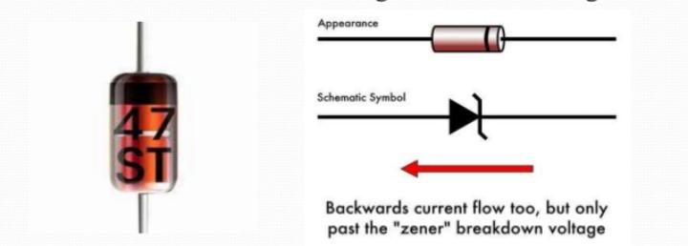
Zener diodes

Slide 5
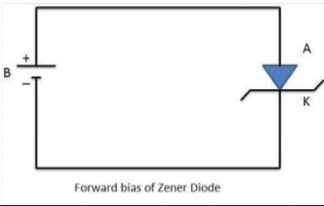
Zener Diode – forward bias
When a Zener diode is forward biased, it operates as a normal diode.
In forward biased P side connected to +ive and N side connected to -ive terminal of battery. In this case the electrons and holes are swept across the junction an large current flow through it.

Slide 6
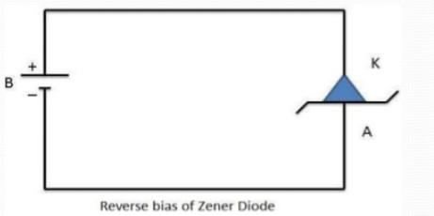
Zener diode – Reverse biased
In case of reverse bias current practically zero and at certain voltage which called Zener voltage the current increases sharply.
Each Zener diode has breakdown rating which specifies the max voltage that can be dropped across it.

Slide 7
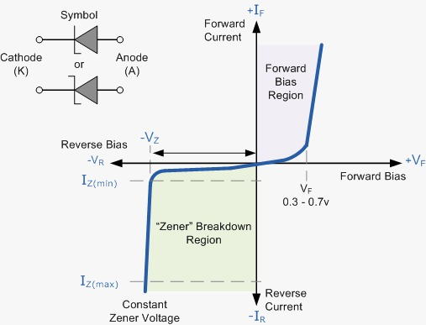
Zener diode V/I characteristics
In the reverse bias region, a reverse leakage current flows until the breakdown voltage is reached.
At this point, the reverse current, called Zener current Iz, increases sharply.

Slide 8
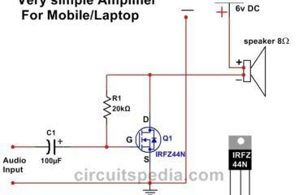
Zener diode application
In this simple illustration of Zener regulation circuit, the Zener diode will adjust its impedance based on varying input voltages. Zener current will increase or decrease directly with voltage input changes. The Zener current Iz, will vary to maintain a constant Vz.

Slide 9
Electrical Charge
Electricity is the movement of electrons. Electrons create charge.
Voltage is the difference in charge between two points.
The unit “volt” represented by the letter “V”.
Current is the rate at which charge is flowing.
Current is measured in Amperes. Amps are represented in equations by the letter “I”.
Resistance is a material’s tendency to resist the flow of charge (current).
Represented in schematics with the greek letter “Ω”, which is called omega, and pronounced “ohm”

Slide 10
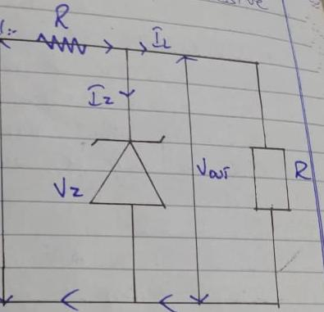
Voltage regulation
It is a measure of circuits ability to maintain a constant output voltage.
A Zener diode when working in a breakdown region serve as a voltage regulator.
Voltage regulator operates in the following cases:

Slide 11
Case - one
Suppose resistance is kept fixed but supply voltage is increased it will increased current.
The increase in current will be absorbtion by the Zener diode without affecting current.
Hence when voltage changes the current and resistance change in such a way as to keep V-out constant.

Slide 12
Case - two
In this case input voltage is fixed but current is change.
When current increase the diode current decreases thereby keeping resistance drop constant.
In this way output voltage remains unaffected.
Vout= Vin-IR = Vin-(Iz-IL)R

Slide 13
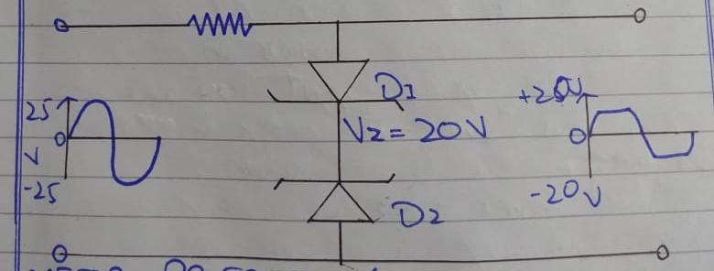
Zener diode as peak clipper
Zener diode is used in wave shaping of circuits.
Take two similar diodes D1, D2 and join them back to back across the input.
During positive input half cycle D1 is shorted but D2 is act as an open.
Therefore it goes into breakdown and holds the output voltage constant.
During the negative half cycle roles of D1 and D2 are reserved.

Slide 14
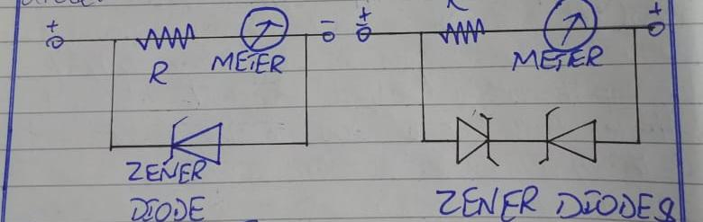
Meter protection
Zener diodes are frequently used in volt-ohm mA for protection meter movement against burn out from accidential overloads.
If the volt meter range is set to 2.5 V but accidently connected to 25 V circuit there will be a burn out which cause severe damage.
This hazard can be avoided by connecting a Zener diode in parallel with the meter so that most of the current will pass through the diode which leads to avoidness of such severe incidents.

Slide 15
AC Power Supply
The sine wave is a common type of alternating current (ac) and alternating voltage.
The time required for a sine wave to complete one full cycle is called the period (T).
Frequency ( f ) is the number of cycles that a sine wave completes in one second.
The more cycles completed in one second. The higher the frequency.
Frequency is measured in hertz (Hz)
Relationship between frequency ( f ) and period (T) is: f = 1/T

Slide 16
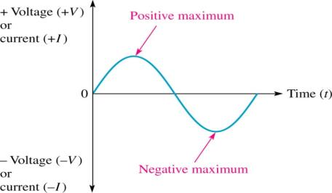

Slide 17
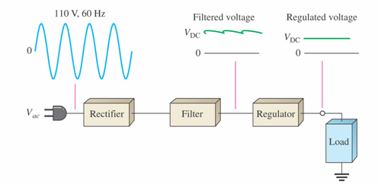


DC Power Supply
Basic components
Rectifier
Filter
Regulator

Slide 18
summary
In this presentation we have discussed about :
Zener diode.
Zener biasing.
V/I characteristics.
Applications.
Voltage regulator.
Zener diode as peak clipper.
Meter protection.

Slide 19
In the absence of information, we jump to the worst conclusions.
That’s It!!!

